Slide 1




WELCOME
IDK

Slide 2

DAY
03
ARRAYS & STRINGS
IDK

Slide 3
TABLE OF CONTENTS
01
02
Arrays
Strings
IDK

Slide 4

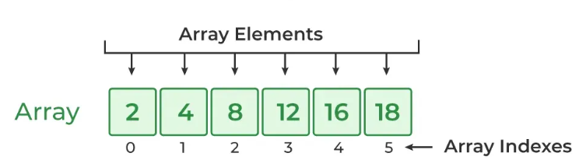
01
Arrays
A fixed-size collection of elements of the same data type.
Linear data structure
Stores in contiguous memory locations.
Each element can be accessed directly using its index.

Slide 5
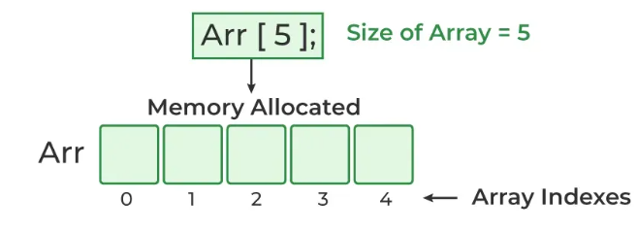
Creating an Array
1. Array Declaration
Array declaration is the process of specifying the type, name, and size of the array.
Syntax
data_type array_name[size];

Slide 6
2. Array Initialization
Initialization in C is the process to assign some initial value to the variable.
Syntax
//Partial Initialisation
int arr[5] = {2, 4, 8};
//Skipping the size of the array.
int arr[] = {2, 4, 8, 12, 16};
//initialize an array with all elements set to 0.
int arr[5] = {0};

Slide 7
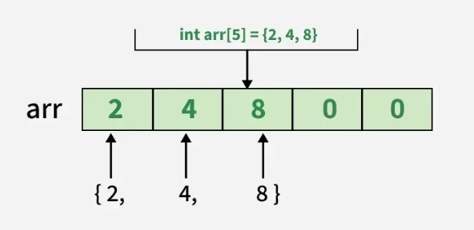
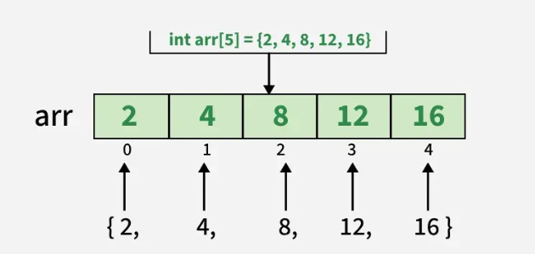
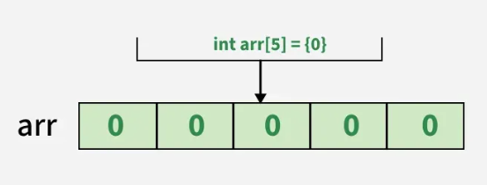
Partial Initialisation
Skipping the size of the array.
initialize an array with all elements set to 0.

Slide 8
ZERO-BASED INDEXING
In C, arrays use zero-based indexing, meaning the count starts at 0.
The first element is at index 0, and for an array of size N, the last element is at index N-1.
Accessing Elements & Looping
Accessing Elements: You can read or change an element's value using its index.
To read the first element: int firstValue = myNumbers[0];
To change the second element: myNumbers[1] = 25;
int myNumbers[ ] = {10, 20, 30, 40, 50};
for (int i = 0; i < 5; i++) {
printf("Element at index %d is %d\n", i, myNumbers[i]);
}

Slide 9
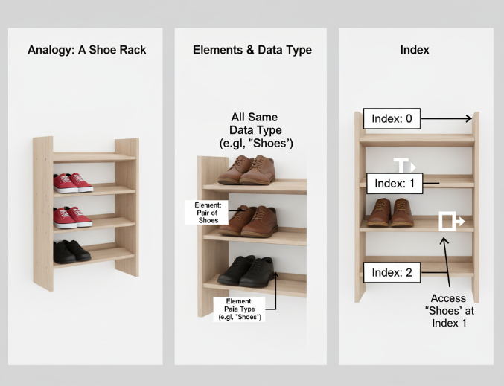
ILLUSTRATIONS

Slide 10

IT’S YOUR TURN

Slide 11
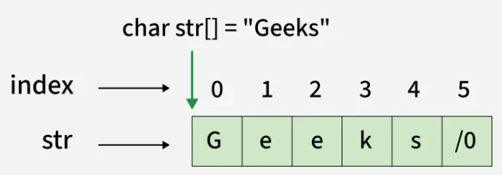
Strings
02
A string is an array of characters terminated by a special character '\0' (null character). This null character marks the end of the string and is essential for proper string manipulation.
Strings are used for storing text/characters.

Slide 12
DECLARATION
char string_name[size];
INITIALIZATION
// Using character list
char str[] = {'G', 'e', 'e', 'k', 's', '\0'};
// Using string literal
char str[] = "Geeks";

Slide 13
String Input/Output (I/O):
Use %s with printf to print a string:
printf("Greeting: %s", greeting);
Use %s with scanf to read a string:
scanf("%s", cityName);

Slide 14
KEY STRING FUNCTIONS
strlen( ) –STRING LENGTH
The strlen() function is used to find the length of a string. It returns the number of characters in a string, excluding the null terminator ('\0’).
char alphabet[] = "ABCDEFGHIJKLMNOPQRSTUVWXYZ";
printf("%zu", strlen(alphabet));

Slide 15
strcpy( ) -COPY STRINGS
The strcpy() function copies a string from the source to the destination. It copies the entire string, including the null terminator.
char str1[20] = "Hello World!";
char str2[20];
// Copy str1 to str2
strcpy(str2, str1);
// Print str2
printf("%s", str2);

Slide 16

ILLUSTRATIONS

Slide 17
IT’S YOUR TURN

Slide 18



TIPS
LOGIC
DISCUSS
SOLVE

Slide 19
“Smart data structures and dumb code works a lot better than the other way around.” - Eric S. Raymond

Slide 20

THANK YOU!

Slide 21


OUR MENTORS
YOUR NAME
YOUR NAME

Slide 22
RECAP
ARRAYS
STRINGS
SECTION

